Slide 1
SARCASTIC NEWS CLASSIFICATION AND SUMMARIZATION
Group 7
Nawshin Nusrat
Kartik Jain
Siddharth Das

Slide 2
Objective
Building a language model that understands sarcasm
Classify sarcastic and non sarcastic news headlines
Text summarizing using transformer to generate sarcastic headlines from the articles.
Classification Techniques:
Classical Models: Random Forest, MLP, LR
MLP + GloVe Embedding
LSTM cells
Transformers: BERT + MLP, RoBERTa + MLP
Summarization Techniques:
T5-small-headline-generator
T5-small (base model)
Explainability

Slide 3
DATA SOURCE
Dataset: Kaggle, News Headlines Dataset For Sarcasm Detection.
There are a total of 55,328 articles with headlines. There are 29,970 real and 25,358 sarcastic news articles.
Dataset Example
{"article_link": "https://www.huffingtonpost.com/entry/versace-black-code_us_5861fbefe4b0de3a08f600d5",
"headline": "former versace store clerk sues over secret 'black code' for minority shoppers",
"is_sarcastic": 0}
This dataset consists of four attributes:
headline: the headline of the news article
article_link: link to the original news article
Body: text from news article
is_sarcastic: 1 if the record is sarcastic, else 0

Slide 4
PREPROCESSING
For classification problem, we applied following text processing techniques on the news headline texts:
Removed numbers, punctuations, and other noisy characters using regular expression
Lowered the text characters
Removed stop words using NLTK package
Lemmatizing texts

Slide 5
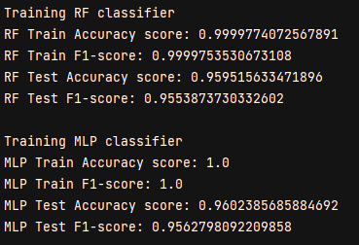
CLASSIFICATION
Classical Models
Run to set baseline score for different models
Data split into train and test dataframes
Data is not preprocessed; passing raw data to TFIDF giving better results
TFIDF converts input data to vectors with high dimensionality
Models used for comparison from scikit-learn package:
Logistic Regression
Random Forest Classifier
Multi-Layer Perceptron (MLP)

Slide 6
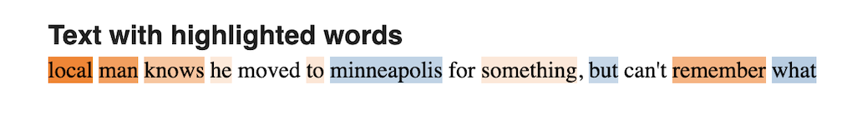
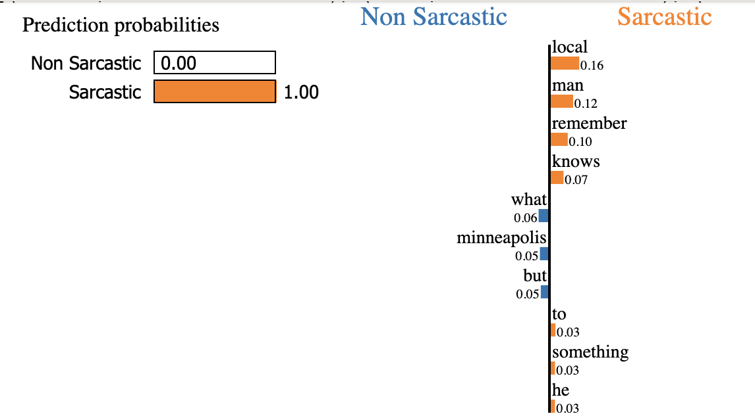
Model Explainability : LIME
Helps to explain the prediction of black box models
Build a simple model in the neighborhood of the a data point
Plots the feature weights

Slide 7
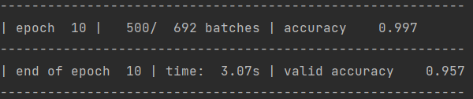
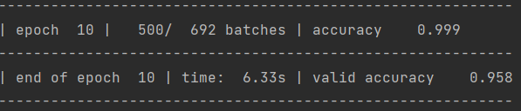
CLASSIFICATION
MLP / RNN using GloVe Embedding
GloVe pre-trained embedding with size 50 used to fit model
Model weights unfrozen during training to give better scores
Output passed to fully-connected layer with or without prepending RNN layer
MLP with GloVe model
RNN with GloVe model

Slide 8
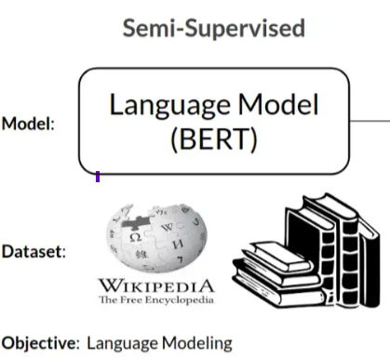
CLASSIFICATION
Transformers - BERT + MLP
Pre-Trained Model
Optimizer: AdamW
Epoch: 4
Batch Size: 8
Maximum Length of Sequence: 256
Learning Rate: 1e-6
Loss function: Cross Entropy
Train Accuracy: 0.97
Test Accuracy: 0.94
Dropout [0.3]
Linear Layer [768,384]]
GeLU
Dropout [0.3]
Linear Layer [384, 2]
GeLU
Model Architecture

Slide 9
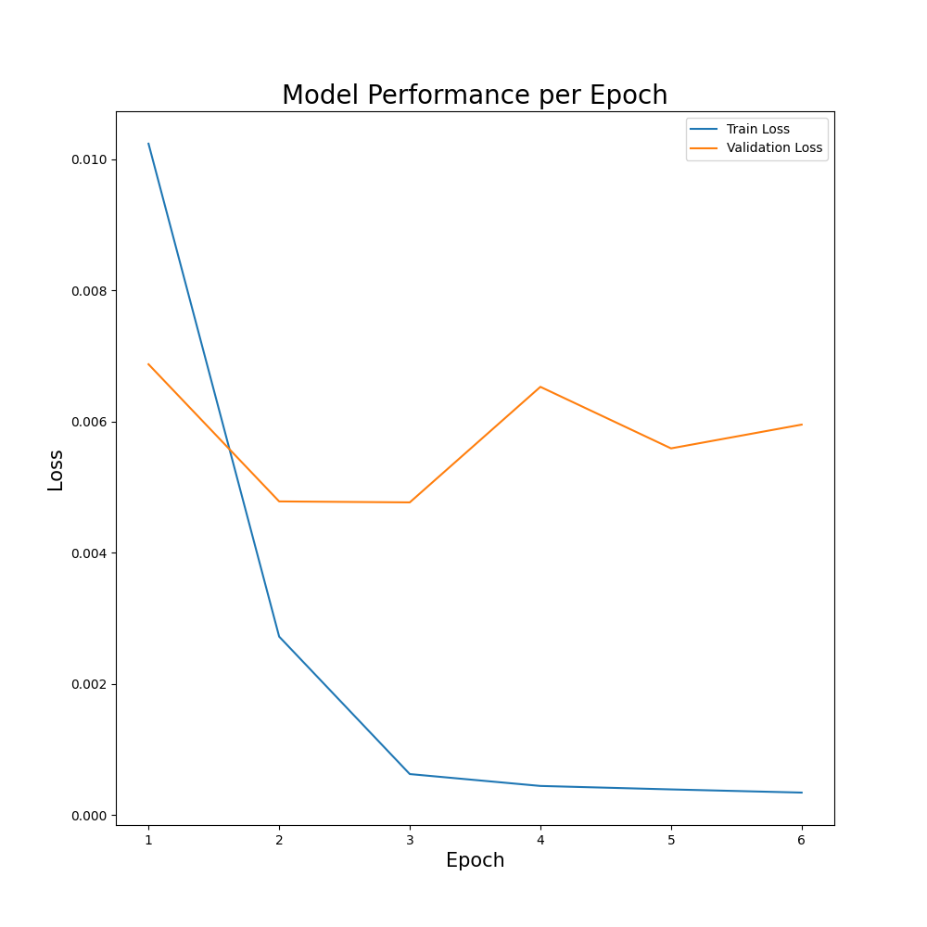
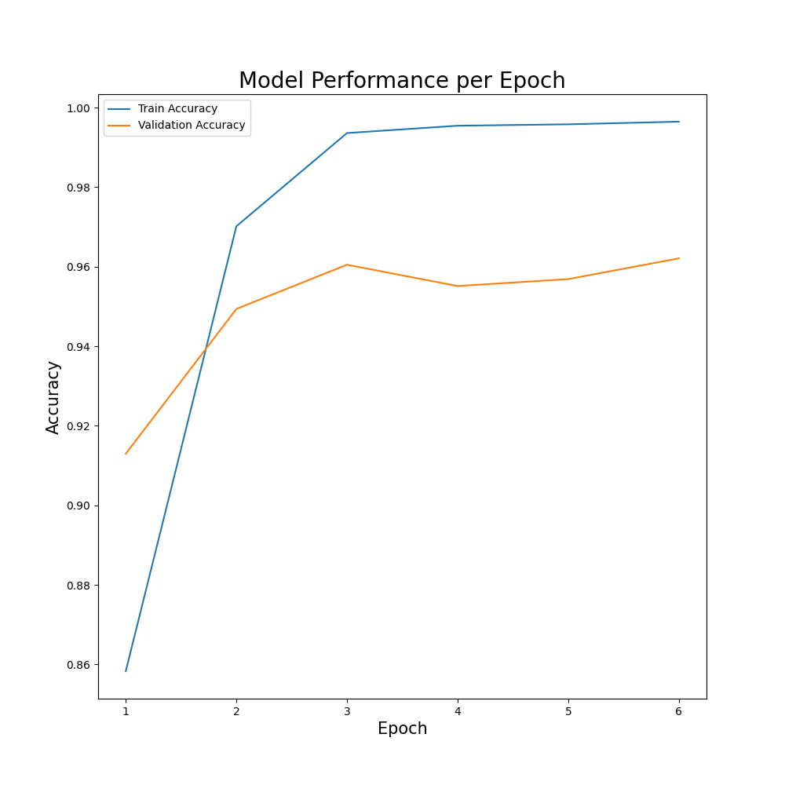
CLASSIFICATION
Transformers - RoBERTa + MLP
Pre-Trained Model
RoBERTa
MaxPool1d
Linear Layer [768,2]]
Model Architecture
LogSoftmax
Optimizer: Adam
Epoch: 6
Batch Size: 32
Maximum Length of Sequence: 107
Learning Rate: 1e-5
Loss function: KL Divergence
Train Accuracy: 0.99
Test Accuracy: 0.962

Slide 10
CLASSIFICATION
Model | Optimizer | Epochs | Batch Size | Max_Len | Learning Rate | Train Accuracy | Test Accuracy
Logistic Regression | - | - | - | - | - | 0.96 | 0.94
Random Forest | - | - | - | - | - | 0.99 | 0.95
MLP | - | - | - | - | - | 1.00 | 0.96
MLP + GloVe Embeddings | Adam | 10 | 64 | 50 | 0.001 | 0.99 | 0.95
RNN + GloVe Embeddings | Adam | 10 | 64 | 50 | 0.001 | 0.99 | 0.96
BERT + MLP | AdamW | 4 | 8 | 256 | 1e-6 | 0.97 | 0.94
RoBERTa | Adam | 6 | 32 | 107 | 1e-5 | 0.99 | 0.962

Slide 11
CLASSIFICATION
Errors
Type-1 Error | Type-2 Error
dad straps baby to steering wheel and spins him around | kanye west jumps on massage table to deliver speech about relaxation
i reunited with my birth mother, who says she wishes she never had me and that i would die | the backstreet boys or 'n sync release new album
knobby-faced beast may be earliest known to stand tall on all fours | christian science pharmacist refuses to fill any prescription
how do we allow a gunman to come into our children's school? | ben affleck defends decision to set 'argo' in boston
woman plunges 6 feet down open new jersey cellar | the titanic scenario: could it really happen?

Slide 12
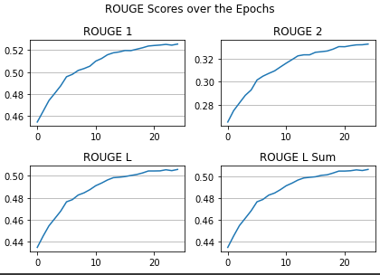
SUMMARIZATION
T5-small-headline-generator
Text-to-Text Transfer Transformer model
This model is a t5-small fine-tuned for headline generation using the JulesBelveze/tldr_news dataset
We use lead-1 baseline to set the baseline scores instead of lead-3. It returns the first line of the text as the summary.
Optimizer: AdamW
Batch Size: 16
Epoch: 25
Learning Rate = 2e-5
Baseline Scores on validation set:
ROUGE1 : 0.305 ROUGEL : 0.280
ROUGE2 : 0.151 ROUGELsum : 0.280
Final ROUGE scores:
ROUGE1 = 0.5255
ROUGE2 = 0.3326
ROUGEL = 0.5057
ROUGELsum = 0.506
Notes:
T5 encoder-decoder model pre-trained on a multi-task mixture of unsupervised and supervised tasks

Slide 13
SUMMARIZATION
T5-small-headline-generator
Predictions
Original Sarcastic Headlines | Predicted News Headlines
real life "twister" kills 117 | super-duper 'twister' kills 117
coworker obsessively checks e-mail every couple of minutes | coworker checks e-mail every two minutes
content could be hotter, more social | content could be hotter, more social, more shareable
mathematician has popular equation stuck in head all day | mathematicians have the pyragorean theorem running through head
headphones-wearing pedestrian loudly proclaims iron man status | man proclaims iron man status while walking down hennepin

Slide 14
CONCLUSION
All the classification model including the classical models display a good accuracy.
Summarization using T5-small-headline-generator, which is specifically trained on news headlines dataset is predicting sarcastic headlines with 50% ROUGE scores
Limitation on the computing power restricted model building on higher hyperparameters like batch size, optimizers and bigger transfer models
In the future work, we intend to improve the architectures to give results faster

Slide 15
Thank You

